Slide 1

Communication Skills
Levels & Barriers

Slide 2
Levels of Communication
Intrapersonal Communication
Interpersonal Communication
Organisational Communication
Mass Communication
Extra-personal Communication

Slide 3
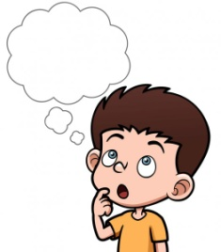
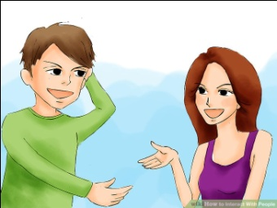
Intrapersonal Communication
Communication within an individual
Self-talk & Introspection
Interpersonal Communication
Sharing of information among people
Close proximity to others and in the course of communication many sensory channels are engaged and there is an immediate feedback
It can be formal or informal

Slide 4


Organisational Communication
Communication in an organization occurs at various hierarchical levels.
Internal
External
Personal
Mass Communication
A large set of audience/readers
Impersonality
Presence of a gatekeeper

Slide 5

Extrapersonal Communication
Communication between human beings and non-human beings.

Slide 6
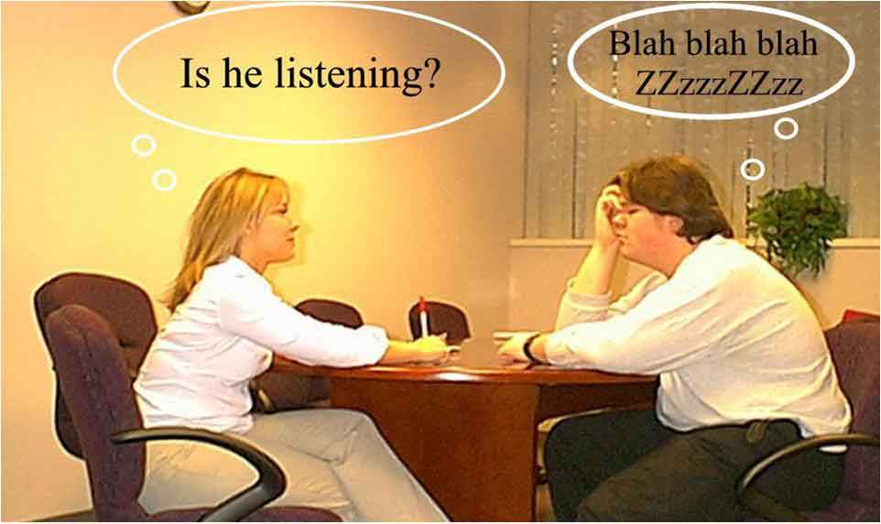
Barriers to Communication
Communication is not possible if it doesn’t create the desired impact on the receiver
Barrier to communication stands for distortion of the message
There are three kinds of barriers based on the process of message formation and delivery.
Intrapersonal
Interpersonal
Organizational

Slide 7
Intrapersonal Barrier
We interpret the information according to our understanding and perspective.
Intrapersonal barriers result form an individual's attitude and habits.
The most common reasons for such barriers are:
1. Wrong assumption 2. Varied perception 7. Emotional disturbance
3. Differing backgrounds 4. Wrong inferences 8. Linguistic limitation
5. Blocked categories 6. Categorical thinking 9. Cultural variation

Slide 8
2. Interpersonal Barriers
The inappropriate transactions of words between two or more people results in interpersonal barrier. The obvious reasons for such barriers are:
1. Linguistic limitation 2. Incompatibility (clash) of verbal and non-verbal message
3. Emotional outburst 4. Communication selectivity
5. Cultural variations 6. Noise in the channel

Slide 9
3. Organizational Barriers
Organizational barrier is not confined to an individual or two people, it exists in the whole organization.
Organizational barriers can be categorized as follows:
1. Too many transfer stations 2. Fear of superiors
3. Use of inappropriate media 4. Information overload
5. Negative Tendencies

Slide 10
How to remove barriers
know your audience
remove prejudice
avoid jargons, uncommon words
use common forms and style of language
encode message well
avoid physical psychological barriers
listen and read carefully
be precise
be open
explore culture

